Slide 1
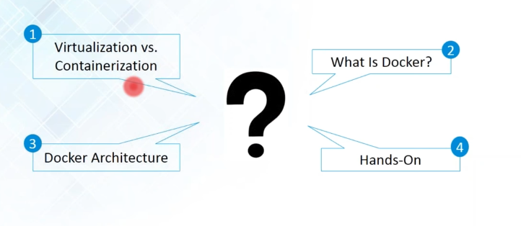
Docker

Slide 2
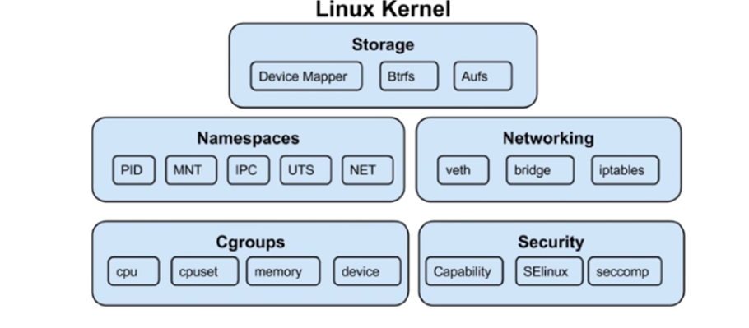
Docker Internals

Slide 3
Docker Internals
Container are method of operating system virtualization that allow you to run application and its dependencies in resource isolated process.
Containers allows you to easily package an application code, configurations and dependencies into easy to use building blocks and that application can be deployed quickly and consistently regardless of deployment environment

Slide 4
Docker Internals
Linux kernel features that create the walls between container and other processes running on the host.
To understand Containers We have to start with Linux Cgroup and Namespace & Union File System.
Linux Namespace - Wrap a set of system resources and present them to a process to make it look like they are dedicated to that process.

Slide 5
Docker Internals
Linux Cgroup - Governs the isolation and usage of system resources such as cpu and memory for group of process.E.g. - If you have a application that takes up lot of cpu cycles and memory such as scientific computing application you can put the application in a cgroup to limit a CPU and memory usage.

Slide 6
Docker Internals
Namespaces deal with resource isolation for single process
Cgroup manages resources for group of processes

Slide 7
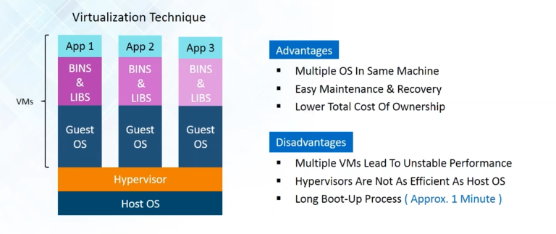
Virtualization

Slide 8
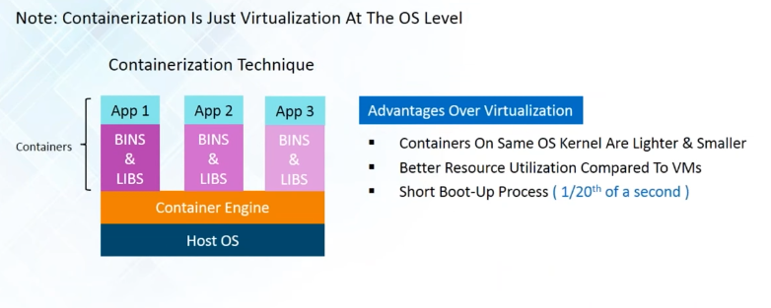
Containerization

Slide 9
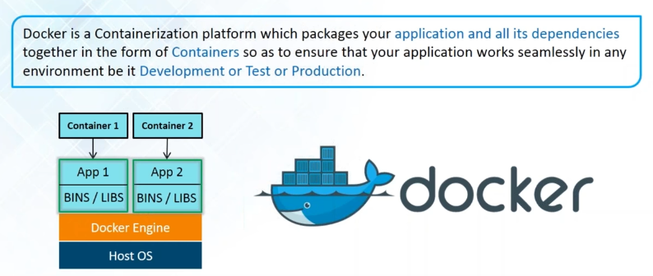
Docker Info

Slide 10
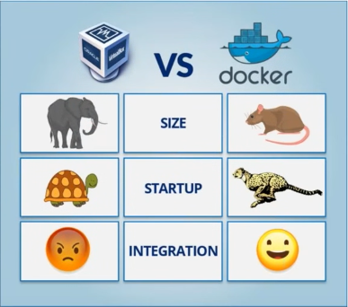
Docker Info

Slide 11
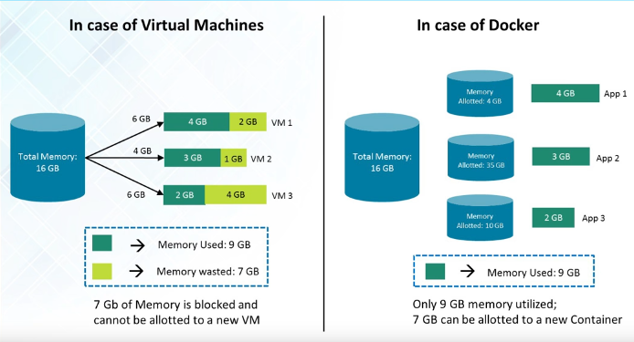
Docker Info

Slide 12
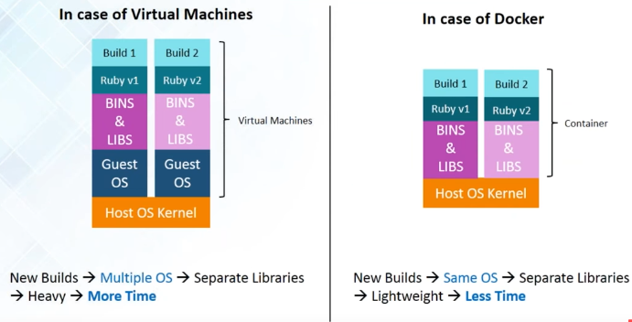
Docker Info

Slide 13
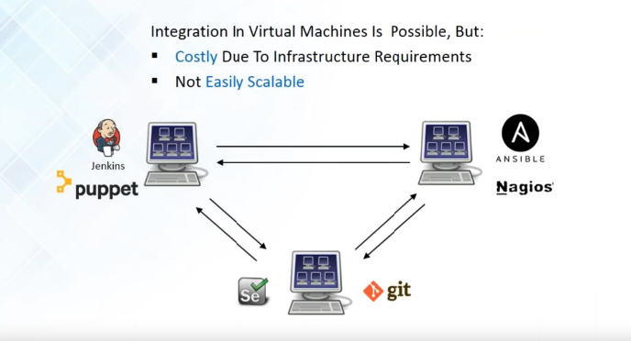
Integration in VMs

Slide 14
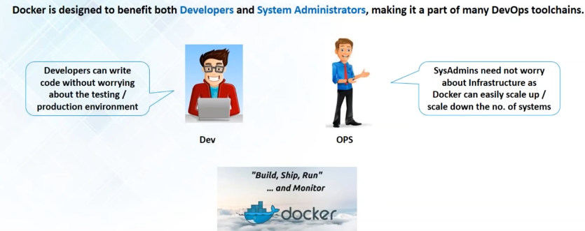
Who Can Use Docker

Slide 15
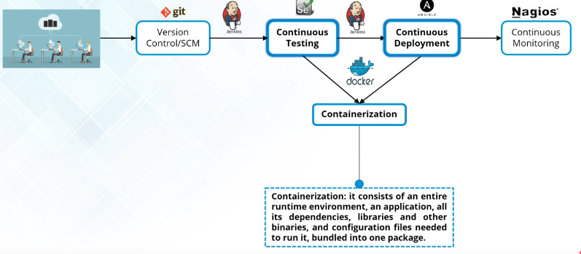
How is Docker Used In Devops

Slide 16
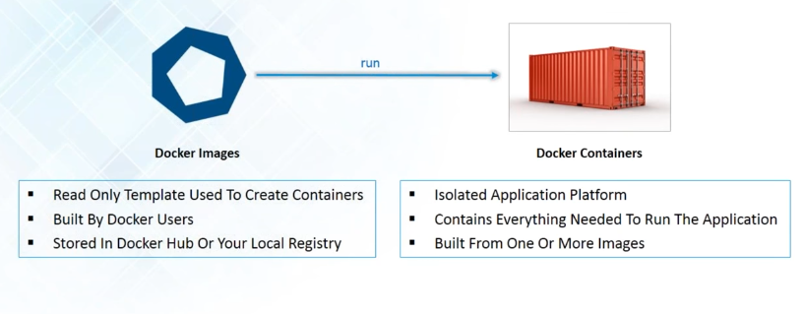
Docker Images & Containers

Slide 17
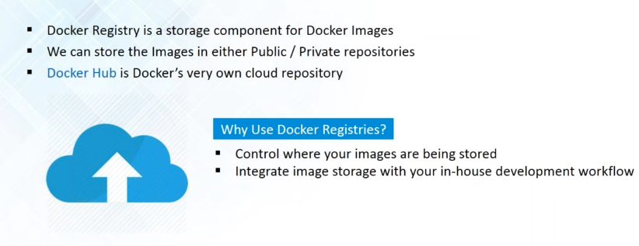
Docker Registry

Slide 18
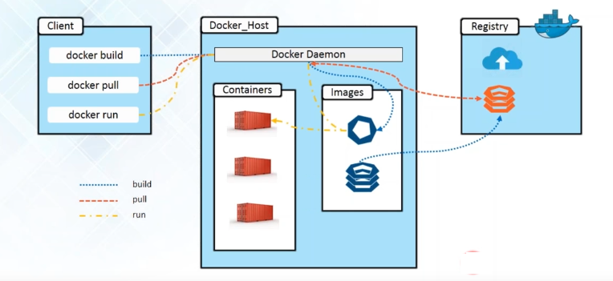
Docker Architecture

Slide 19
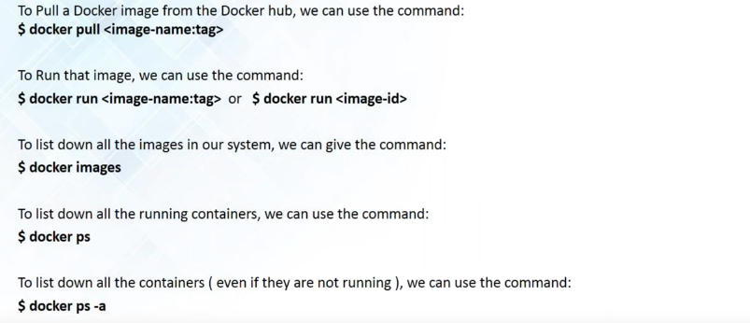
Basic Docker Commands

Slide 20
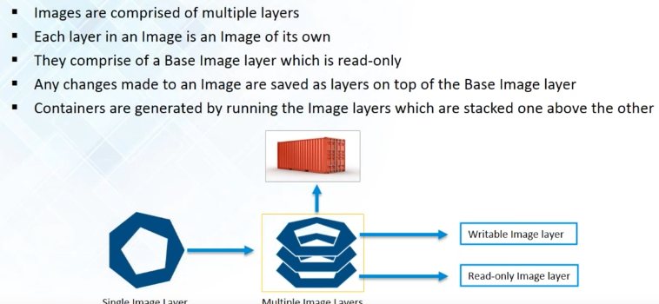
Building Images

Slide 21
Docker File Instructions https://docs.docker.com/engine/reference/builder/#environment-replacement
Instruction | Comments
FROM <image>:<tag> | Tells Docker what will be the base for the image being created
ADD | Copies the files from the source on the host into the Docker image's own filesystem at the desired destination. Command is not only about copying files from the local filesystem--you can use it to get the file from the network.
COPY | It will copy new files or directories from <source path> and adds them to the filesystem of the container at the path <destination path>.
CMD / ENTRYPOINT | CMD ["executable","parameter1","parameter2"] his is the so-called exec form CMD command parameter1 parameter2 This a shell form of the instruction
RUN | Instruction will execute any commands in a new layer on top of the current image and then commit the results
EXPOSE | Instruction informs Docker that the container listens on the specified network ports at runtime.

Slide 22
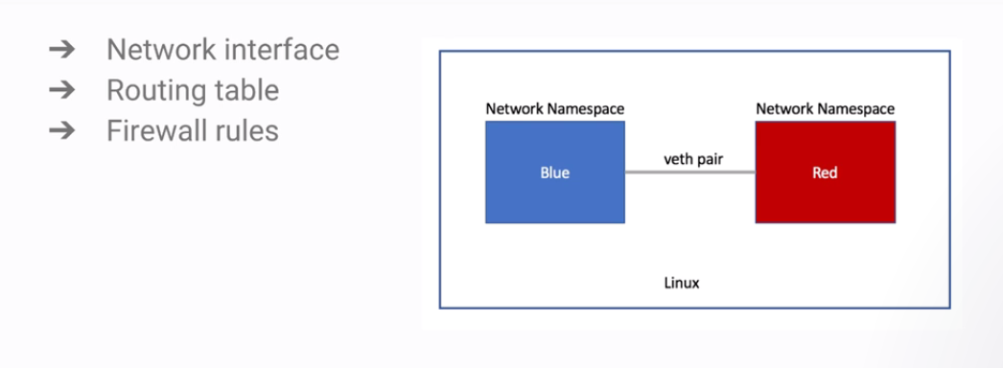
Docker Networking: Linux Network Namespace

Slide 23
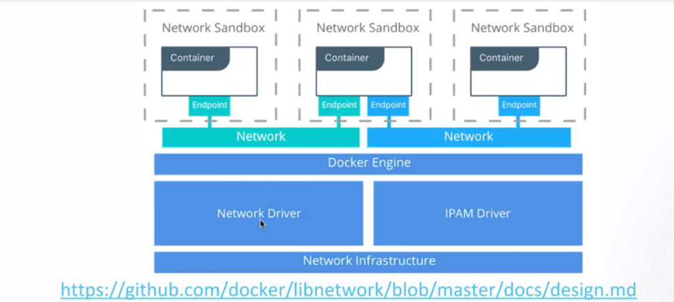
Container Networking Model (CNM)

Slide 24
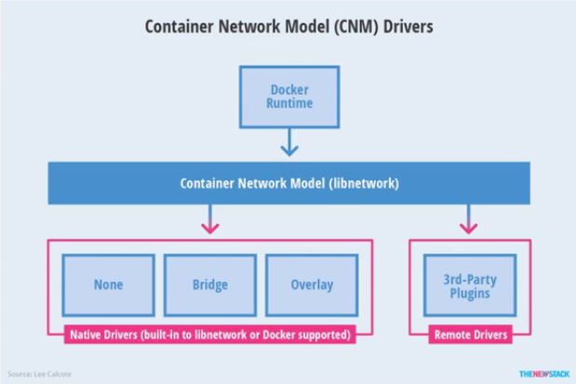
Container Networking Model

Slide 25
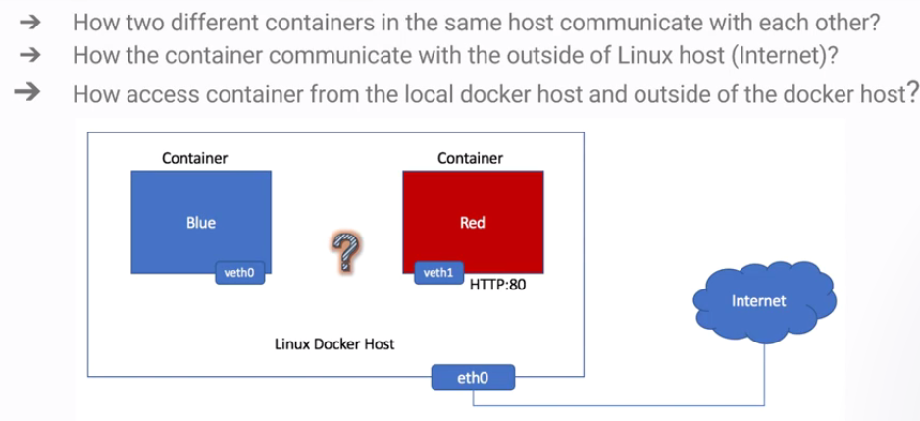
Single Host Container Networking

Slide 26
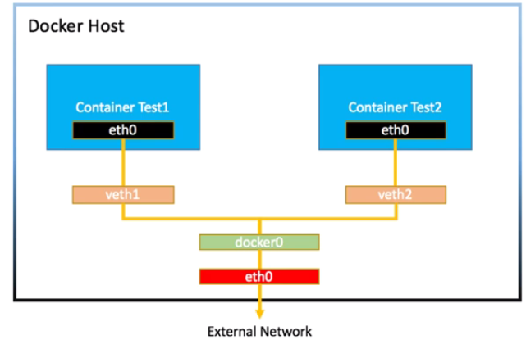
Solution: Linux Bridge and Iptables

Slide 27
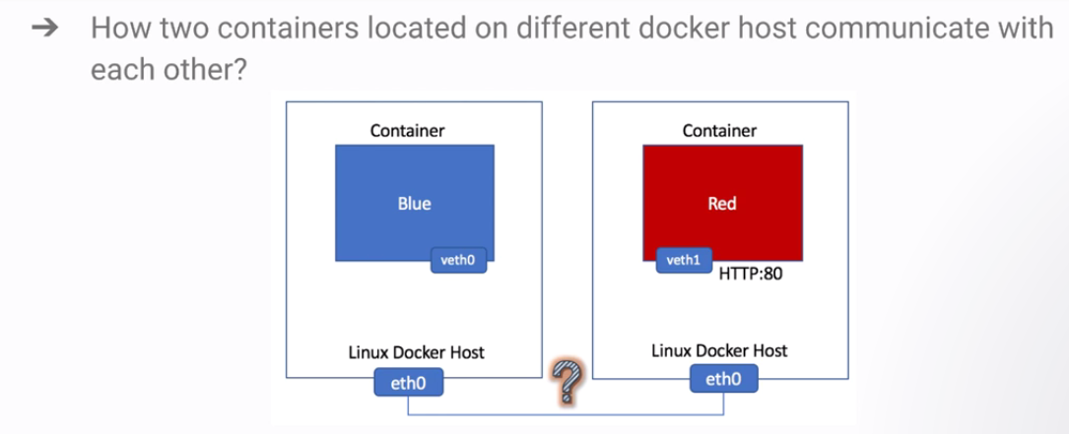
Multi Host Container Networking

Slide 28
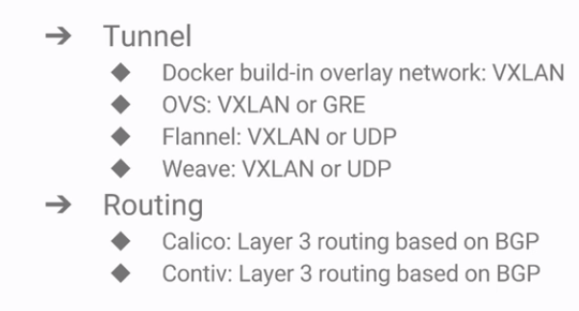
Solution: Tunnel and Routing

Slide 29
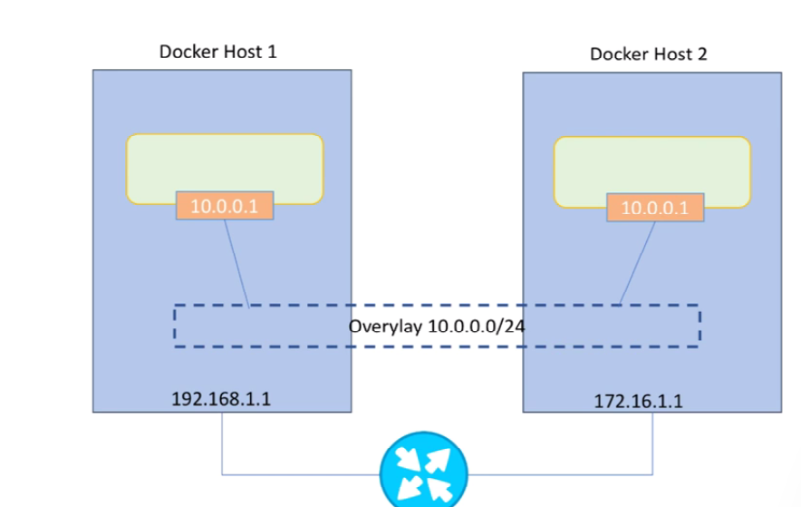
Multi Host Networking

Slide 30
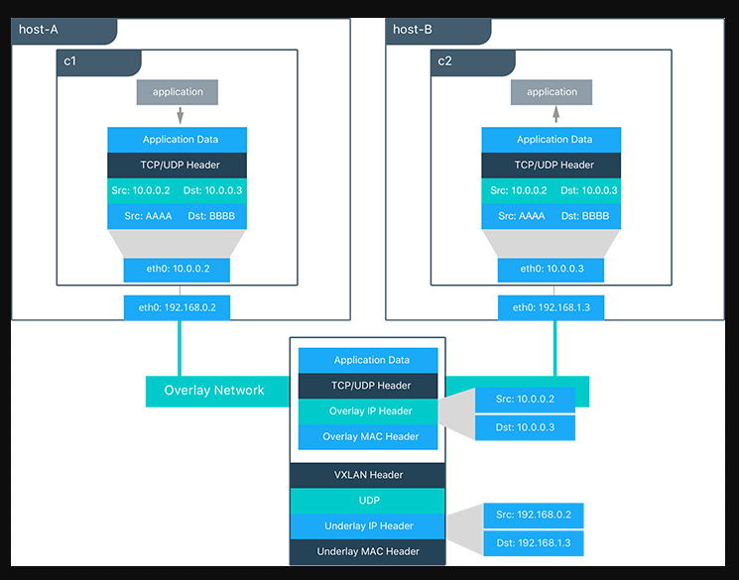

Slide 33
Docker Compose

Slide 34
Multi-container apps are a hassle
Build images from Dockerfiles
Pull images from the Hub or a private registry Configure and create containers
Start and stop containers

Slide 35
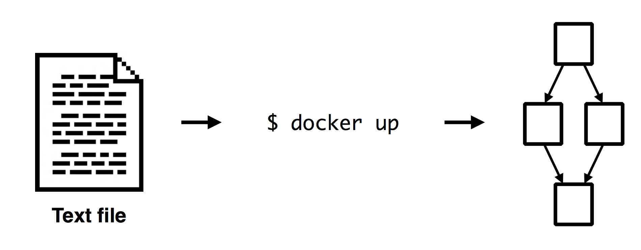
Docker Compose

Slide 36
Overview
•Compose is a tool for defining and running multi-container Docker applications. With Compose, you use a Compose file to configure your application’s services. Then, using a single command, you create and start all the services from your configuration.

Slide 37
app.py
from flask import Flask
from redis import Redis
import os
import socket
app = Flask(__name__)
redis = Redis(host=os.environ.get('REDIS_HOST', 'redis'), port=6379)
@app.route('/')
def hello():
redis.incr('hits')
return 'Hello Container World! I have been seen %s times and my hostname is %s.\n' % (redis.get('hits'),socket.gethostname())
if __name__ == "__main__":
app.run(host="0.0.0.0", port=5000, debug=True)

Slide 38
requirements.txt
flask
redis

Slide 39
Dockerfile
FROM python:2.7
MAINTAINER Peng Xiao "xiaoquwl@gmail.com"
COPY . /app
WORKDIR /app
RUN pip install -r requirements.txt
EXPOSE 5000
CMD [ "python", "app.py" ]

Slide 40
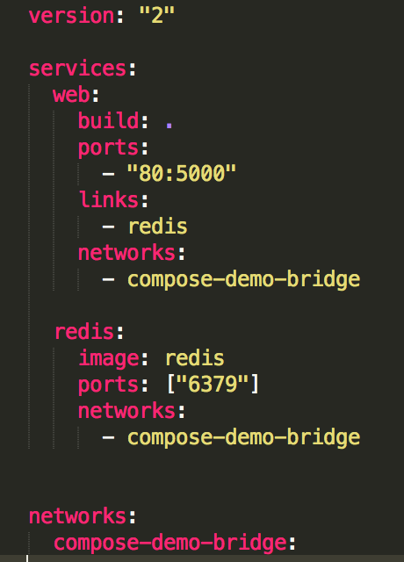
docker-compose.yml
web
redis
compose-demo-bridge

Slide 41
Docker Swarm

Slide 42
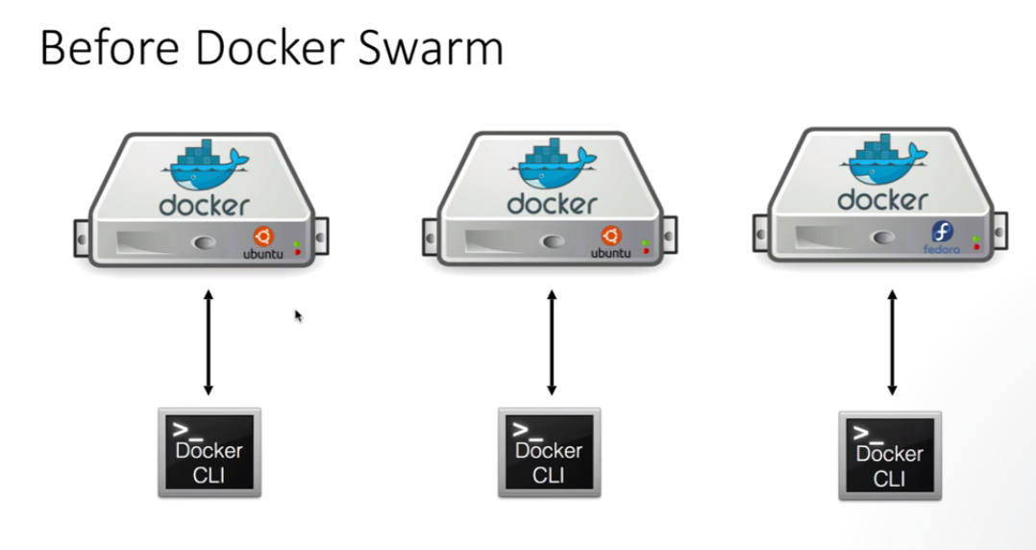

Slide 43
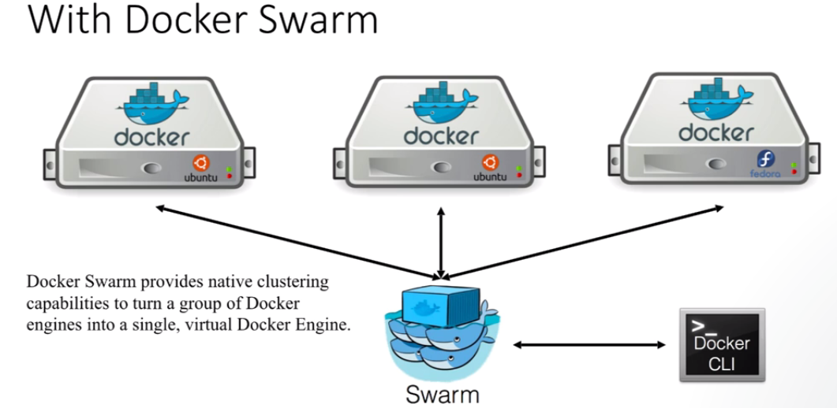

Slide 44
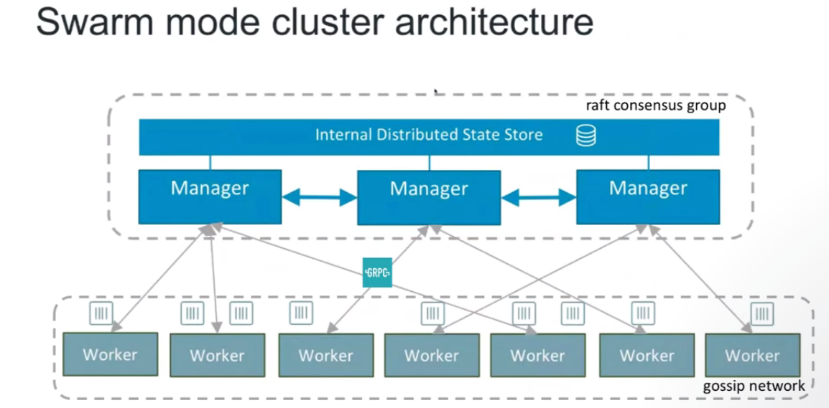

Slide 45
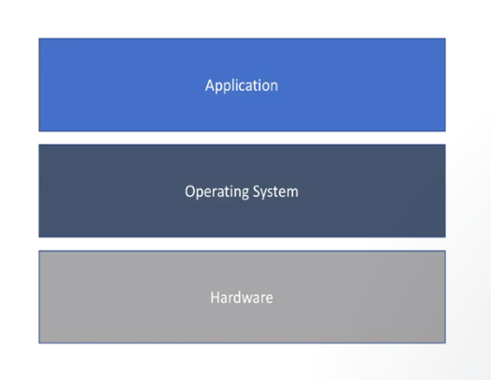
In the very Beginning…

Slide 46
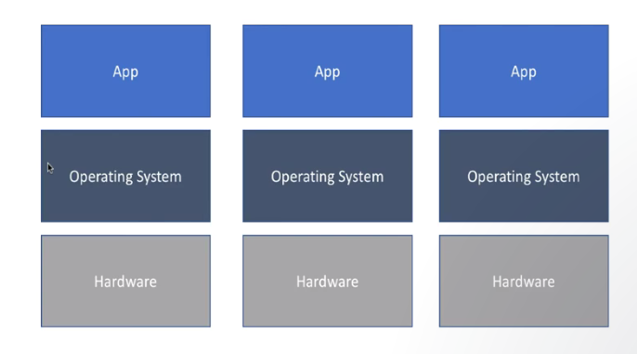
Scale & High Availability

Slide 47
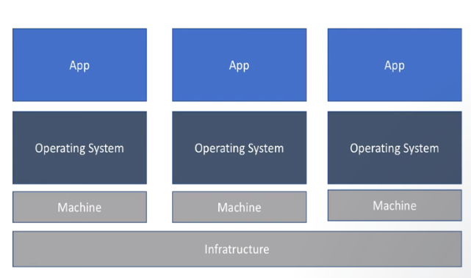
Hardware Virtualization

Slide 48
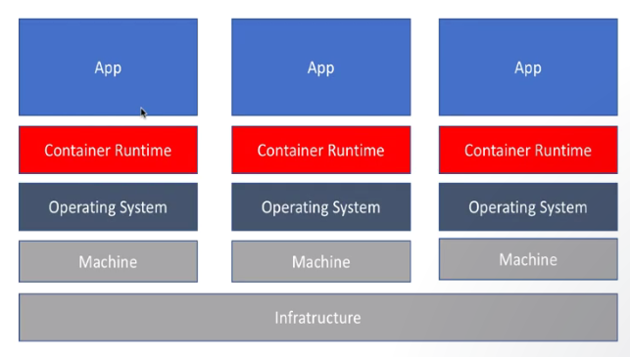
Containerized

Slide 49
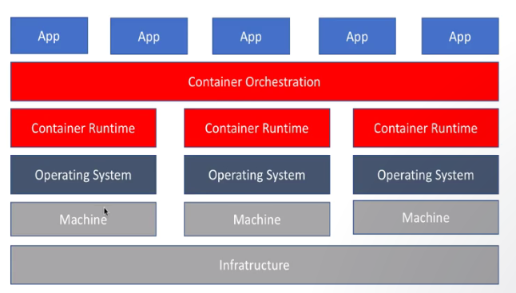
Container Orchestration

Slide 50
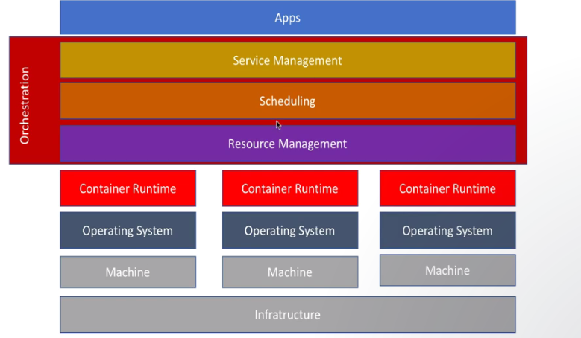
Container Orchestration

Slide 51
Container Orchestration
Schedule Containers to physical/virtual machines
Restart containers if they stop
Provide private container network
Scale up and Scale down
Service Discovery

Slide 52
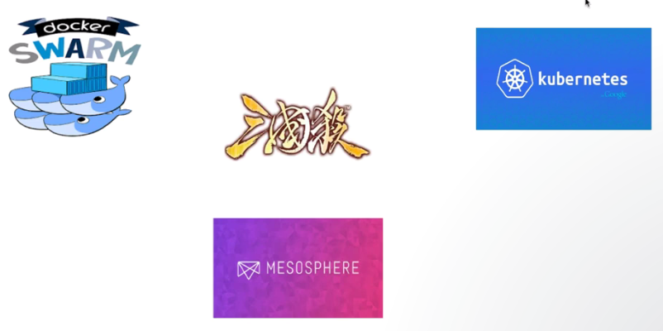
Container Orchestration war

Slide 53
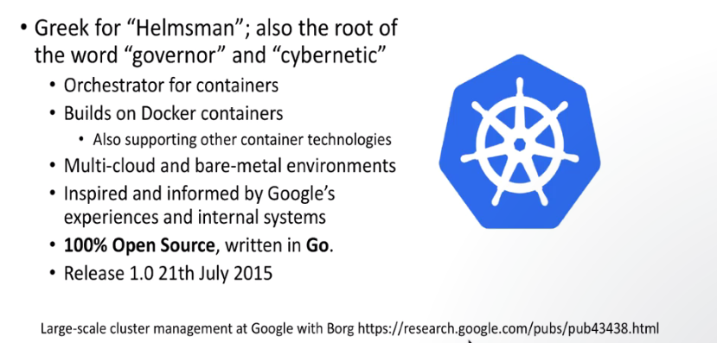
Kubernetes

Slide 54
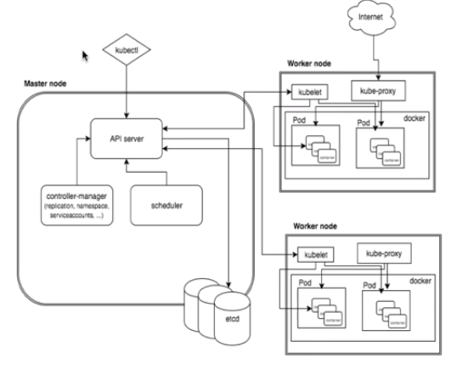
Kubernetes Architecture

Slide 55
Kubernetes Deploymnet

Slide 56
Kubernetes Pod
Pods- Pods are smallest deployable unit of computing that can be created and managed in kubernetes
It is group of 1 or more containers. A pods are always co-located and co-scheduled and run in shared context
Shared context of pod is a set of linux namespaces and cgroups, same thing that isolated docker containers.
Containers within a pods share an same p address and pod space and find each other using localhost.
They can communicate with each other using standard IPC communication.

Slide 57
Kubernetes Replication Controller
It ensures that specified number of pods/replicas are running at any point of time.
In other words replication controller make sure that pods or homogeneous set pod s are always up and available.
If there are too many pods it will kill excess one and if there are less pods it will create new one to maintain that state.

Slide 58
Deployment
It provides updates for pods and replica sets .
Replica sets is the next generation of replication controller.
You only need to describe a desired state in a deployment object
And Deployment controller will change actual state to desired state.
You can define a Deployments to create new resources or replace existing ones by new ones.

